Slide 1
SC-400T00A Microsoft Information Protection and Compliance Administrator
Author name

Slide 2
Implement Data Loss Prevention

Slide 3
Outline
Prevent data loss with Microsoft Purview
Implement Endpoint data loss prevention
Configure DLP policies for Microsoft Defender for Cloud Apps and Power Platform
Manage DLP policies and reports in Microsoft Purview

Slide 4
Prevent data loss with Microsoft Purview

Slide 5
Agenda: Prevent data loss with Microsoft Purview
Discuss the data loss prevention solution and its benefits.
Describe the data loss prevention configuration process.
Explain what users will experience when the solution is implemented.

Slide 6
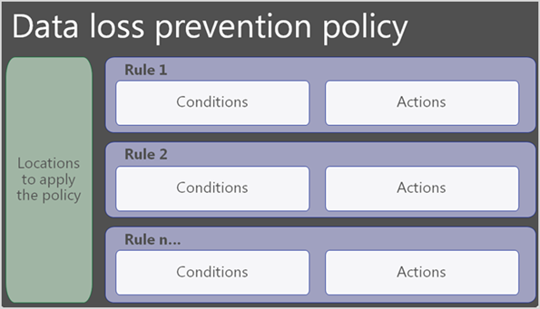
Data loss prevention overview
Each DLP policy contains:
Where to protect the content
Content is protected in locations like SharePoint Online, Exchange Online, OneDrive accounts, Microsoft Teams chat and channel messages, and Windows 10 or higher devices.
When and how to protect the content
When and how to protect the content is defined by enforcing rules. A policy contains one or more rules, and each rule consists of conditions and actions at a minimum.
Notes:
Supporting videos for instructor or student use:
Understanding and maximizing the value of Microsoft’s DLP Approach
https://www.youtube.com/watch?v=aI3OYUNhKnw
(15 minutes)

Slide 7
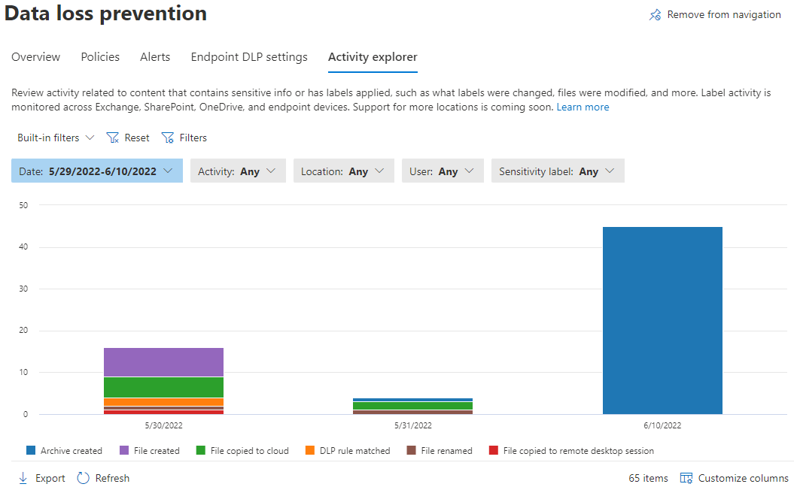
Identify content to protect
Use the following to identify content:
Content explorer
Content explorer identifies the email and documents in your organization that contain sensitive information.
Activity explorer
Activity explorer includes information on activity related to content that contains sensitive information, which can also inform what should be protected by DLP policies.

Slide 8
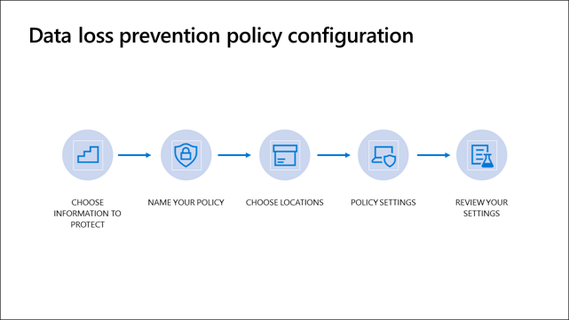
Define policy settings for your DLP policy
To create a DLP policy go to the Microsoft Purview Portal

Slide 9
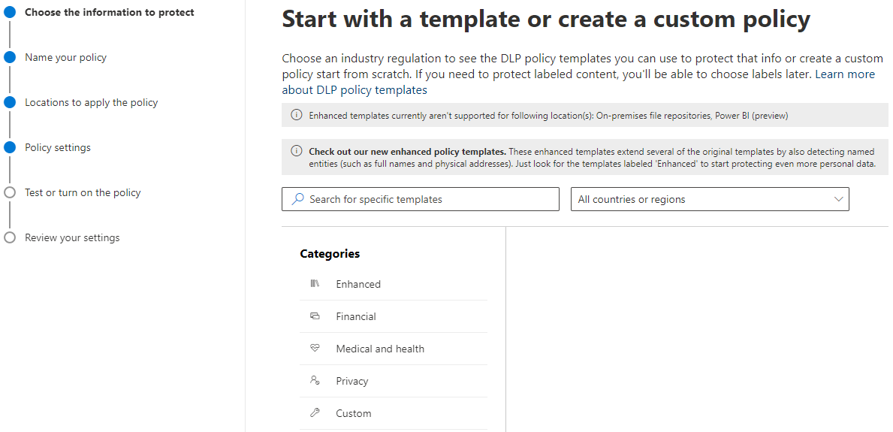
Choose the information to protect
DLP policy templates consist of one or more sensitive info types grouped into categories:
Enhanced
Financial
Medical and health
Privacy
Custom

Slide 10
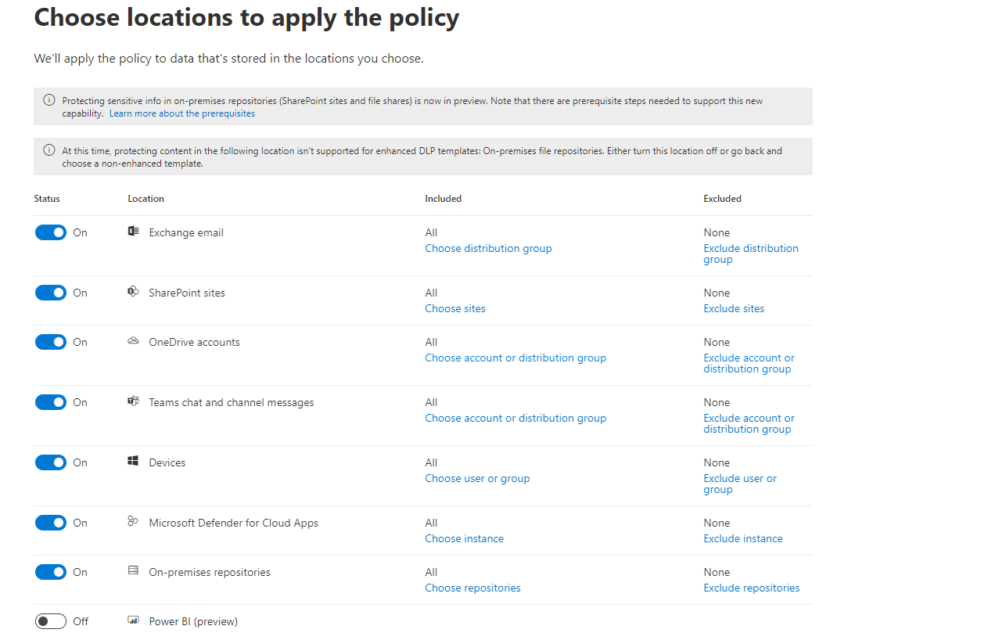
Choose locations to apply the policy
Locations are places or service the DLP policy will apply to:
Exchange Online email
SharePoint Online sites
OneDrive accounts
Microsoft Teams chat and channel messages
Devices
Microsoft Defender for Cloud Apps
On-premises repositories
Power BI (preview)

Slide 11
Define policy settings
DLP policy rules include:
Conditions
Determine what types of information you are looking for, and when to take an action.
Exceptions
Prevents the application of a rule for content matching the exceptions.
Actions
When content matches a condition in a rule, you can apply actions to automatically protect the content.
User notifications
Use notifications to educate your users about DLP policies and help them remain compliant without blocking their work.
User overrides
Allows the user to override the policy and share the content.
Incident reports
With a matched rule, you can send an incident report to your compliance officer with details of the event.

Slide 12
Test or turn on your DLP policy
Use test mode to gauge impact before policy activation.
Policy matches will be reported to you in emails or through DLP reports.
Test mode allows you to activate policy tips without enforcing protective actions.
Policy tips allow users to flag false positives.
Configure exceptions to the policy to reduce false positives.

Slide 13
Configure DLP policies for Power BI
Power BI supports Microsoft Purview data loss prevention (DLP) polices to detect and protect sensitive data in sensitive datasets.
DLP Policies for Power BI:
Apply to workspace hosted in Premium Gen2.
Support sensitivity labels and sensitive info types as conditions.
Only work as stand-alone policies with no other locations.
Are still in public preview.

Slide 14
Configure DLP for on-premises repositories
DLP for on-premises repositories detect and protect sensitive data stored in on-premises repositories such as file shares and SharePoint document libraries.
Requirements:
The Azure Information Protection (AIP) scanner. Your installation must meet all the prerequisites for AIP, the AIP client, and the AIP unified labelling scanner.
There must be at least one label and policy published in the tenant.

Slide 15
Implement the Microsoft Purview Extension
Microsoft Purview Extension allows users working with sensitive information using the Chrome browser.
Same granular functionality with Chrome browser as with Edge.
Companies are enabled to enroll the Chrome browser as an alternative to Edge.
Purview Extension is available in the Chrome web store for users to install as extension or for centralized deployments:
Single devices
Self-service installation by the end user.
Centralized Deployment
Deployment using Microsoft Endpoint Manager and Configuration Profile.
Legacy Deployment
Deployment via Group Policy Object (GPO).
Note: Deployment via Endpoint Manager or GPO prevents users from deactivating the extension.
Tip: When the Chrome browser remains on the “unsupported browsers” list, the browser is still eligible for working with sensitive information when the Microsoft Purview Extension is installed and enabled.

Slide 16
Guided demonstration – DLP policies for Microsoft Teams
Scenario:
Task 1
Add Microsoft Teams as a location to an existing policy
You are the compliance administrator tasked with configuring data loss prevention policies for Microsoft Teams.
Task 2
Create a new DLP policy from a template
Task 3
Create a new custom DLP policy
Task 4
End user experience and reporting
Notes:
This recorded demo is provided to give learners a sense of the experience of creating and editing DLP policies.
Follow the annotations and advice for where to click.
Time required: 15 minutes
Guided demo link: https://teams-dlp-interactive-guide.azureedge.net/

Slide 17
Implement Endpoint data loss prevention

Slide 18
Agenda: Implement Endpoint data loss prevention
Prepare your environment for Endpoint DLP
Onboard devices to Endpoint DLP
Configure global Endpoint DLP settings

Slide 19
Prepare for Endpoint DLP
Endpoint DLP extends the activity monitoring and protection capabilities of DLP to sensitive items on Windows 10, Windows 11, and macOS
File type limitations exists
Unsupported file types can create opportunities for data loss
Management of Endpoint DLP policies can be completed by a Compliance Admin
Devices are monitored by Microsoft Defender for Endpoint
Devices onboarded for Defender are automatically also onboarded for Endpoint DLP
Notes:
Supporting videos for instructor or student use:
Endpoint Data Loss Prevention (DLP) – Data Loss Prevention across endpoints, apps, & services | Microsoft Purview - YouTube
https://www.youtube.com/watch?v=hvqq8L_0kgI&ab_channel=MicrosoftMechanics
(12 minutes)

Slide 20
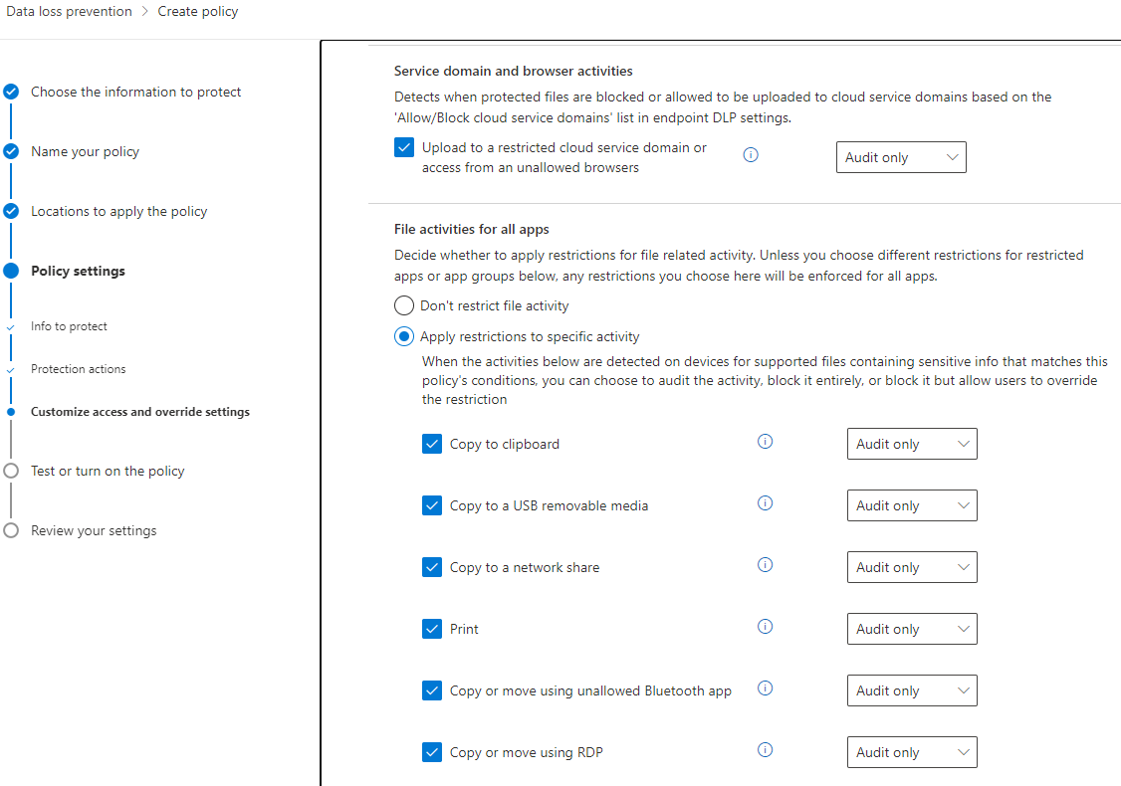
Prepare for Endpoint DLP (continued)
Endpoint DLP only protects data:
All Endpoint DLP policies end at the border of the device
Policies allow you to audit or restrict:
Uploading to restricted cloud service domains
Access by unallowed browsers
Copying to the clipboard from protected items
Copying protected items to USB removable media
Copying to network shares
Printing protected items
Access by unallowed (bluetooth) apps
Copy or move using RDP

Slide 21
Onboard devices for Endpoint DLP (Windows 10 and 11 only)
Device management is turned off by default and needs to be enabled first
Local Script
Use a local script to onboard a maximum of 10 devices for testing purposes.
Group Policy
Use this method if you are looking to mass onboard devices for Endpoint DLP and you do not plan on using Configuration Manager or an MDM solution.
Configuration Manager
Use this method if you are looking to mass onboard devices for Endpoint DLP if you do not plan on using an MDM solution.
MDM/Intune
Use this method if you are looking to mass onboard devices for Endpoint DLP and do not plan on using Configuration Manager.
VDI Scripts
Use this method if you need to onboard VDI clients. The provided scripts work for more than 10 devices.

Slide 22
Onboard devices for Endpoint DLP (macOS)
MacOS device monitoring must be turned on to use Endpoint DLP for macOS devices
MacOS devices must be already managed through Intune or JAMF Pro
MacOS devices must be within three latest released versions
Endpoint DLP supports Microsoft Edge, Safari, Chrome, and Firefox on macOS
MacOS devices that have Microsoft Defender for Endpoint deployed to them have a simpler deployment process
Copy activities, print, upload to cloud, unallowed apps are activities that can be monitored and restricted for macOS
Notes:
Onboarding clients with Microsoft Defender for Endpoint: https://www.youtube.com/watch?v=ROyaVuqtBrE&ab_channel=MicrosoftSecurity (3 minutes)

Slide 23
Configure global Endpoint DLP settings
Endpoint DLP settings create a framework in which Endpoint DLP policies work
File path exclusions:
Are applied to all Endpoint DLP policies
Allow you to limit where your policies are in effect
Restricted apps:
Are applied when a policy blocks unallowed apps
Allow you to limit where you can work with protected files
Browser and domain restrictions:
Are applied when a policy blocks unallowed browsers
Allow you to limit where you can share protected files
Advanced classification scanning and protection:
Can use EDM and named entities in your DLP policies
Business justification in policy tips:
Show default options and custom text box
Only show default options and/or custom text box

Slide 24
Supported Endpoint DLP settings
Endpoint DLP settings supported for Windows 10/11 and macOS
Windows 10/11 devices:
Restricted app groups
Unallowed Bluetooth apps
Browser and domain restrictions to sensitive items
Additional settings for Endpoint DLP
Always audit file activity for devices
Auto-quarantine file from unallowed apps
Advanced classification
Business justification in policy tips
macOS devices:
Browser and domain restrictions to sensitive items
Additional settings for Endpoint DLP
Always audit file activity for devices
Business justification in policy tips
Notes:
Only discuss these differences if time is available

Slide 25
Guided demonstration – Endpoint DLP
Scenario:
Task 1
You are the compliance administrator tasked with configuring data loss prevention for endpoints in your organization.
Review Endpoint DLP Settings
Task 2
Create and review DLP policy for Endpoints
Task 3
Validate the user experience
Task 4
Review data classification
Notes:
This recorded demo is provided to give learners a sense of the experience of creating and managing Endpoint DLP policies.
Follow the annotations and advice for where to click.
Time required: 30 minutes
Guided demo link: https://ms-endpoint-dlp.azureedge.net/

Slide 26
Configure DLP policies for Microsoft Defender for Cloud Apps and Power Platform

Slide 27
Agenda: Configure DLP policies for Microsoft Defender for Cloud Apps and Power Platform
Configure data loss prevention policy and rule priorities
Implement DLP policies in test mode
Configure Data loss prevention policies in Power Platform
Integrate DLP Policies into Defender for Cloud Apps for advanced functionality

Slide 28
Configure DLP policies for Microsoft Power Platform
Power Platform DLP policies restrict communication between connectors
Policies can be configured on a tenant or environment level
Connectors can be sorted into three groups and only reside in one at a time:
Business
Non-business
Blocked
Certain connectors cannot be sorted into the blocked group
Connectors can only communicate with other connectors in their group

Slide 29
Combine DLP with Microsoft 365 Defender
Create file policies in Microsoft 365 Defender and use the Data classification service:
You need to enable file monitoring
File policies allow you more granular control over Microsoft cloud apps
Create DLP policies in the Purview portal and select Microsoft 365 Defender as a location:
DLP policies monitor third party apps you connected to Microsoft 365 Defender(Box, Dropbox, Salesforce, etc.)
Protective actions are limited by the API of the third-party app
Notes:
Supporting videos for instructor or student use:
Protect your sensitive data in the cloud with Microsoft 365 Defender
https://www.youtube.com/watch?v=a6lK3TVVW-M
(2 minutes)

Slide 30
Configure file policies in Microsoft 365 Defender
File policies can use the Microsoft 365 Defender DLP engine or the same Data Classification Services as DLP policies
You can configure real-time alerts or review alerts via reports
File policies are configured in the Microsoft 365 Defender portal
There is no test mode for file policies, actions will be applied as soon as the policy exists
Use the preview functions to see the files your policy would match if you saved it

Slide 31
Manage DLP violations in Microsoft 365 Defender
Violations of file policies only show up in the Microsoft 365 Defender dashboard and the individual policy matches overview
Use the policy overview to review matches of the policy and fine tune your filters
Get a history of past matches to see where your policy had an effect
Use the quarantine view to see files that have been quarantined because of governance actions
Modify file policy filters and review the effects your policy changes have on your environment before commiting to them by using the preview function

Slide 32
Manage DLP policies and reports in Microsoft Purview

Slide 33
Agenda: Manage DLP policies and reports in Microsoft Purview
Review and analyze DLP reports
Manage permissions for DLP reports
Identify and mitigate DLP policy violations
Configure DLP for policy precedence

Slide 34
Configure data loss prevention for policy precedence
Policy Precedence: Configure the order in which DLP rules are evaluated to establish priority and ensure desired actions take precedence.
Avoid Override Conflicts: Set priorities to prevent less restrictive rules from overriding stricter ones, maintaining data protection and compliance.
DLP policies follow a specific order of policy precedence, where rules are processed based on assigned priority numbers, with lower numbers processed first.
Prioritizing policies and rules with more restrictive actions ensures that desired actions take precedence over potential overrides and conflicts.
By configuring policy and rule priorities, organizations can effectively manage DLP enforcement, minimize conflicts, and maintain data protection and compliance.

Slide 35
Implement data loss prevention policies in test mode
Purpose of Test Mode
Configuring Test Mode
Monitoring and Adjusting Policies
Evaluate the impact and effectiveness of DLP Policies.
Monitor policy performance before activating it.
Receive incident reports via email for analysis.
Start policy creation process.
Choose user notification options.
Enable test mode and show policy tips if desired.
Use Activity Explorer to review policy matches.
Adjust sensitivity and add exceptions.
Activate policy tips to gather user feedback.

Slide 36
Explain data loss prevention reporting capabilities
DLP Activity Explorer:
Review events and activity related to sensitive information.
View label changes, file modifications, and rule matches.
Exporting DLP Reports:
Use PowerShell module to export activities.
Specify time range and output format.
Contextual Summary:
Enable Advanced classification scanning for additional details.
DLPRuleMatch events provide matched content information.
DLP Alerts in Defender for Cloud Apps Dashboard:
Access dashboard for DLP alerts and matches.
Identify sensitive information type, location, policy, and user.

Slide 37
Manage permissions for DLP reports
Any role group with the View-Only DLP Compliance Management role can view DLP reports
The Security Reader (Azure AD) role group can view all Security and Compliance related topics
The Security Reader (Exchange) role group is synchronized with the Security Reader (Azure AD) role group
Use the Security & Compliance Center to assign permissions
Exchange role groups can sound similar to Azure AD role groups but have different scopes

Slide 38
Manage and respond to DLP policy violations
DLP policies do not make decisions about the validity of a policy violation
Compliance officers have the task of monitoring reports and need to decide if violations require technical or organizational actions.
Compliance admins should be aware of escalation processes and contacts in other departments to coordinate a unified response to violations.
Use Exclusions in your DLP rules to limit the amount of false positives you get
Allow users to override the protective actions of specific DLP policies if you identified legitimate use cases in past responses to policy violations

Slide 39
Knowledge check
1
A user sends an email to several recipients containing 16 unique credit card numbers that match a single DLP Policy rule with this sensitive information type. How many lines will display on the DLP Policy matches report?
1
3
5
2
Maintaining patient privacy is a top priority in the Health Care industry. As a senior care facility, what best practice should you employ using the ready-to-use U.S personal information policy template?
Create a custom policy to identify HIPAA-protected information.
Turn on the policy right away.
Test the policy before releasing it.
3
Microsoft Defender for Cloud Apps built-in DLP engine performs content inspection by extracting text from all common file types including which of these file types?
BTML
XML and HTML
All file types

Slide 40
Lab – Implement Data Loss Prevention

Slide 41
Lab Exercises
Exercise 1: Manage DLP policies
Exercise 2: Manage Endpoint DLP
Exercise 3: Manage DLP reports

Slide 42
Closing slide

